Slide 1
Amazon GLUE

Slide 2
AWS GLUE
Agenda:
What is AWS Glue
Why to use AWS Glue
An example use case for AWS Glue
What makes AWS Glue server-less
Populating the AWS Glue Data Catalog
Summary about AWS Glue
When is AWS Glue a wrong choice
2

Slide 3
AWS GLUE
What is AWS Glue:
AWS Glue is a server-less ETL tool in cloud.
In brief ETL means extracting data from a source system, transforming it for analysis and other applications and then loading back to data warehouse.
3

Slide 4
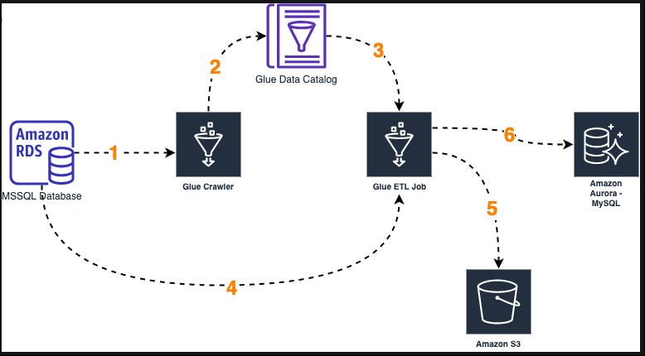
AWS GLUE
4

Slide 5
AWS GLUE
Why to use AWS Glue?
Replacing Hadoop. Hadoop can be expensive and a pain to configure. AWS Glue is simple. Some say that Glue is expensive, but it depends where you compare. Because of on demand pricing you only pay for what you use. This fact might make AWS Glue significantly cheaper than a fixed size on-premise Hadoop cluster
AWS Lambda cannot be used. A wise man said, use lambda functions in AWS whenever possible. Lambdas are simple, scalable and cost efficient. They can also be triggered by events. For big data lambda functions are not suitable because of the 3 GB memory limitation and 15 minute timeout. AWS Glue is specifically built to process large datasets.
5

Slide 6
AWS GLUE
Apply DataOps practices. Drag and drop ETL tools are easy for users, but from the DataOps perspective code based development is a superior approach. With AWS Glue both code and configuration can be stored in version control. The data development becomes similar to any other software development. For example the data transformation scripts written by scala or python are not limited to AWS cloud. Environment setup is easy to automate and parameterize when the code is scripted
6

Slide 7
AWS GLUE
An example use case for AWS Glue
Now a practical example about how AWS Glue would work in practice.
A production machine in a factory produces multiple data files daily. Each file is a size of 10 GB. The server in the factory pushes the files to AWS S3 once a day.
The factory data is needed to predict machine breakdowns. For that, the raw data should be pre-processed for the data science team.
Lambda is not an option for the pre-processing because of the memory and timeout limitation. Glue seems to be reasonable option when work hours and costs are compared to alternative tools.
The simplest way of get started with the ETL process is to create a new Glue job and write code to the editor. The script can be either in scala or python programming language.
7

Slide 8
AWS GLUE
Extract. The script first reads all the files from the specified S3 bucket to a single data frame. You can think a data frame as a table in Excel. The reading can be just a one-liner.
Transform. This is the most of the code. Let’s say that the original data had 100 records per second. The data science team wants the data to be aggregated per each 1 minute with a specific logic. This could be just tens of code lines if the logic is simple.
Load. Write data back to another S3 bucket for the data science team. It’s possible that a single line of code will do.
The code runs on top of the spark framework which is configured automatically in Glue. Thanks to spark, data will be divided to small chunks and processed in parallel on multiple machines simultaneously.
8

Slide 9
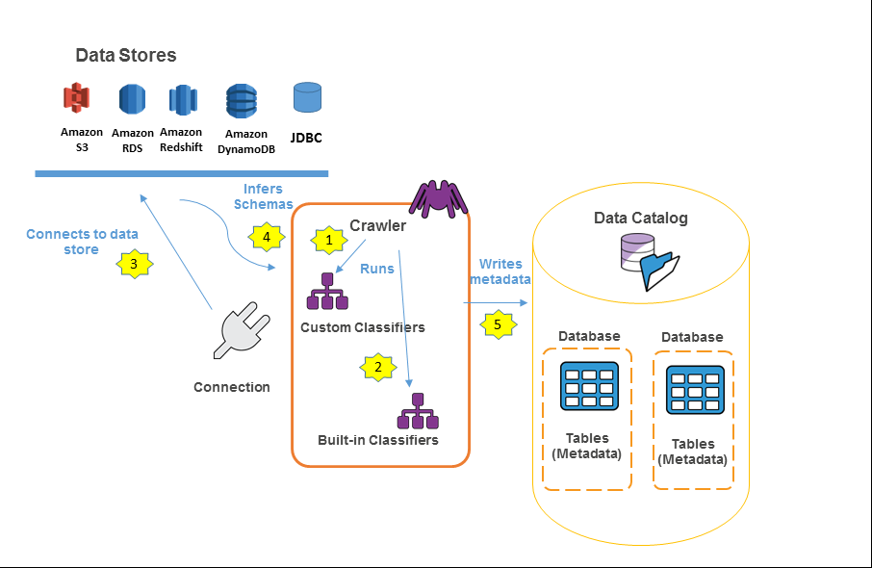
AWS GLUE
Populating the AWS Glue Data Catalog
9

Slide 10
AWS GLUE
The following is the general workflow for how a crawler populates the AWS Glue Data Catalog:
A crawler runs any custom classifiers that you choose to infer the format and schema of your data. You provide the code for custom classifiers, and they run in the order that you specify.
The first custom classifier to successfully recognize the structure of your data is used to create a schema. Custom classifiers lower in the list are skipped. If no custom classifier matches your data's schema, built-in classifiers try to recognize your data's schema. An example of a built-in classifier is one that recognizes JSON.
The crawler connects to the data store. Some data stores require connection properties for crawler access.
The inferred schema is created for your data.
The crawler writes metadata to the Data Catalog. A table definition contains metadata about the data in your data store. The table is written to a database, which is a container of tables in the Data Catalog. Attributes of a table include classification, which is a label created by the classifier that inferred the table schema.
10

Slide 11
AWS GLUE
AWS Glue Data Catalog :
The AWS Glue Data Catalog contains references to data that is used as sources and targets of your extract, transform, and load (ETL) jobs in AWS Glue. To create your data warehouse, you must catalog this data. The AWS Glue Data Catalog is an index to the location, schema, and runtime metrics of your data. You use the information in the Data Catalog to create and monitor your ETL jobs. Information in the Data Catalog is stored as metadata tables, where each table specifies a single data store. Typically, you run a crawler to take inventory of the data in your data stores, but there are other ways to add metadata tables into your Data Catalog.
11

Slide 12
AWS GLUE
What makes AWS Glue serverless:
Serverless means you don’t have machines to configure. AWS provisions and allocates the resources automatically.
The processing power is adjusted by the number of data processing units (DPU). You can do additional configuration, but it’s likely that a proof of concept works out of the box.
In an on-premise environment you would have to make a decision about the computation cluster size. A big cluster is expensive but fast. A small cluster would be cheaper but slow to run.
With AWS Glue your bill is the result the following equation:
12

Slide 13
AWS GLUE
When is AWS Glue a wrong choice
Lots of small ETL jobs. Glue has a minimum billing of 10 minutes and 2 DPUs. With the price of 0.44$ per DPU hour, the minimum cost for a run becomes around 0.15$. The starting price makes Glue unappealing alternative to process small amount of data often.
Specific networking requirements. If you spin up a standard EC2 virtual machine, an IP address will be attached to it. The serverless nature of Glue means you have to put more effort on network planning in some cases. One such scenario would be whitelisting a Glue job in a firewall to extract data from an external system.
13

Slide 14
AWS GLUE
Summary about AWS Glue :
The most common argument against Glue is “It’s expensive”. True, in a sense that the first few test runs can already cost a few dollars. In a nutshell, Glue is cost efficient for infrequent big data workloads.
In the big picture AWS Glue saves a lot of time and unnecessary hardware engineering. The costs should be compared against alternative options such as on-premise Hadoop cluster or development hours required for a custom solution.
14

Slide 15
Thank You

